Slide 1
The Structure of Networks
with emphasis on information and social networks
T-214-SINE Summer 2011
Review
Ýmir Vigfússon

Slide 2
Part I
Chapters 2, 3 and 5

Slide 3
Graph Theory
Graph
Nodes connected by edges
Path
Set of nodes where each consecutive pair is joined by an edge
Component
Set of nodes where each two nodes are connected by some path
Distance
Length of shortest path between two nodes
Breadth-first search (BFS)
Method to find shortest paths from one node to all others

Slide 4
Breadth-first search (BFS)
From the given node (root)
Find all nodes that are directly connected
These are labeled as “distance 1“
Find all nodes that are directly connected to nodes at distance 1
If these nodes are not at distance 1, we label them as “distance 2“
...
Find all nodes that are directly connected to nodes at distance j
If these nodes are not already of distance at most j+1, we label them as „distance j+1“

Slide 5
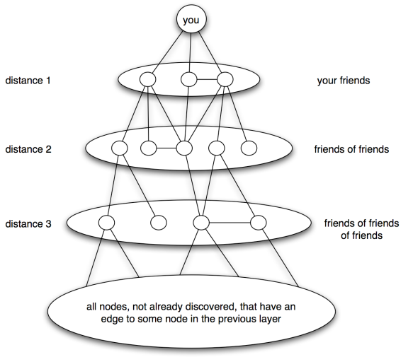
Breadth-first search (BFS)

Slide 6
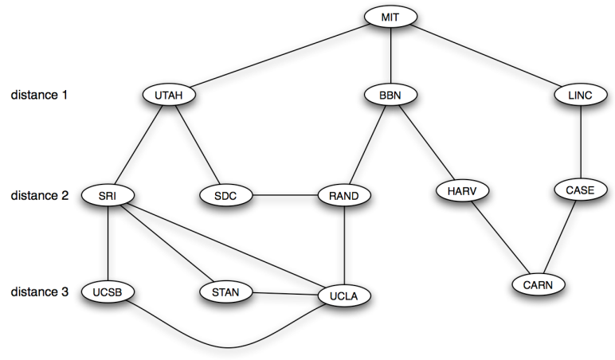
Breadth-first search (BFS)

Slide 7
Strong and Weak Ties
Triadic closure
If two people have friends in common, they‘re more likely to become friends themselves
Clustering coefficient
Over every pair of my friends, what fraction them are friends themselves?
Local bridge
If A and B are friends and have no other friends in common

Slide 8
Strong and Weak Ties
Suppose edges are now either strong (friends) or weak (acquaintances)
Strong Triadic Closure Property (STCP)
For every node A with strong ties to some friends B and C, then B and C are connected by an edge (either weak or strong).
Thm:
If a node A satisfies STCP and is involved in at least two strong ties, then any local bridge it is involved in must be a weak tie

Slide 9
Strong and Weak Ties
People seem to maintain a small number (~40) of strong ties (Facebook/Twitter)
Structural hole:
The „empty space“ or „missing“ edges between groups that don‘t interact much
Betweenness of an edge:
Essentially the number of shortest paths (between pairs of nodes) that use the edge
But if there are multiple shortest paths between A and B, say k of them, the contribution to betweenness of intermediate edges is only 1/k instead of 1

Slide 10
Positive and Negative Relationships
Suppose all edges exist, and are either + (friends) or – (enemies)
(Strong) Structural Balance:
For every set of three nodes, either three + edges or exactly one + edge.
Balance Theorem:
In a balanced complete graph, either all nodes are friends or it can be divided into two coalitions of mutual friends such that people in different groups are enemies

Slide 11
Positive and Negative Relationships
Weak Structural Balance:
No set of three nodes have two + edges and one - edge.
Weak Balance Theorem:
In a weakly balanced complete graph, nodes can be divided into groups of mutual friends such that people from different groups are enemies

Slide 12
Positive and Negative Relationships
What if not all the edges exist?
Thm:
A signed graph is strongly balanced if and only if it contains no cycle with an odd number of negative edges

Slide 13
Part II
Chapters 6, 7, 8, 9

Slide 14
Game Theory
Game theory deals with the outcome of person‘s decisions in various situations
How to choose among different options
People‘s choices when interacting with others
Def: A game consists of three things.
(1) A set of players
(2) Each player has set of options how to behave called strategies
(3) For each choice of strategies, each player receives a payoff from the game.

Slide 15
Game Theory
Your partner
Prisoner‘s dilemma
Each player thinks studying for exam is safer, but this doesn‘t reach the social optimum
 | Presentation | Exam
Presentation | 90,90 | 86,92
Exam | 92,86 | 88,88
You
Strategies
Payoff for
row player,column player

Slide 16
Game Theory
How are the players likely to behave?
Assumptions
The payoff for a player should capture all rewards
Including altruism
Players know all possible strategies and payoffs to other players
Players are rational
Each players wants to maximize her own payoff
Each player succeeds in picking the optimal strategy

Slide 17
Game Theory
Best response
The best choice of one player, given a belief of what the other player will do
E.g. „U is a best response to L“
Dominant strategy
If a strategy is the best response to every strategy of the other player
We can assume it will be played!

Slide 18
Game Theory
Nash equilibrium
For strategy S by player 1 and T by player 2, the pair (S,T) is a Nash equilibrium if S is a best response to T, and T is a best response to S
More generally, a cell in the payoff matrix is a Nash equilibrium if no player wants to unilaterally (i.e. by himself) deviate to an alternative strategy
A game might have multiple Nash equilibria, or none.

Slide 19
Important Games
Battle of the sexes
Which kind of movie to rent?
Two equilibria, but which one will be played?
Hard to predict the outcome
Depends on social conventions
 | Romance | Thriller
Romance | 1, 2 | 0, 0
Thriller | 0, 0 | 2, 1

Slide 20
Important Games
Stag Hunt
If hunters work together, they can catch a stag
On their own they can each catch a hare
If one hunter tries for a stag, he gets nothing
Two equilibria, but “riskier“ to hunt stag
What if other player hunts hare? Get nothing
Similar to prisoner‘s dilemma
Must trust other person to get best outcome!
 | Hunt Stag | Hunt Hare
Hunt Stag | 4, 4 | 0, 3
Hunt Hare | 3, 0 | 3, 3

Slide 21
Game Theory
Mixed strategies
Each player now commits to a strategy with a certain probability
e.g. Player 1 has probability p of choosing strategy H
Nash‘s Theorem:
When we allow mixed strategies, Nash equilibrium always exists.
Social optimum
The cell in the payoff matrix that maximizes the sum of the players‘ payoffs.

Slide 22
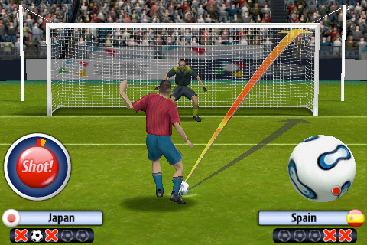
Mixed Strategies: Example
Penalty-kick game
Soccer penalties have been studied extensively
Suppose goalie defends left with probability q
Kicker indifferent when
(0.58)(q) + (0.95) (1-q) = (0.93)(q) + (0.70) (1-q)
Get q =0.42. Similarly p=0.39
True values from data? q=0.42 , p=0.40 !!
The theory predicts reality very well
 | Defend left | Defend right
Left | 0.58, -0.58 | 0.95, -0.95
Right | 0.93, -0.93 | 0.70, -0.70

Slide 23
Evolutionary Game Theory
Game theory continues to apply even if no individual is overtly reasoning or making explicit decisions
Natural selection
More fit organisms will produce more offspring
This causes genes that provide greater fitness to increase their representation in the population
But how do we measure „fitness“?

Slide 24
Evolutionary Game Theory
Key insight
Many behaviors involve the interaction of multiple organisms in a population
The success of an organism depends on how its behavior interacts with that of others
Can‘t measure fitness of an individual organism
So fitness must be evaluated in the context of the full population in which it lives
Analogous to game theory
Organisms‘s genetically determined characteristics and behavior = Strategy
Fitness = Payoff
Payoff depends on strategies of organisms with which it interacts = Game matrix

Slide 25
Evolutionary Game Theory
What happens at equilibrium?
Nash equilibrium doesn‘t make sense since no individual is changing their strategy
Evolutionarily stable strategy
A strategy is evolutionarily stable if everyone uses it, and any small group of invaders with a different strategy will die off over multiple generations

Slide 26
Evolutionary Game Theory
Organism 2
Theorem
Strategy S in a two-player, two-strategy symmetric game is evolutionarily stable when either (i) a > c or (ii) a = c and b > d
Theorem
If strategy S is evolutionarily stable, then (S,S) is a Nash equilibrium.
If (S,S) is a strict Nash equilibrium, then strategy S is evolutionarily stable.
 | S | T
S | a, a | b, c
T | c, b | d, d
Organism 1

Slide 27
Routing Games
Players (drivers) commuting from some node s to t
All players are making private decisions about what path to drive to minimize latency
Latency of an edge depends on the number of drivers
Q: What happens at equilibrium?
Don‘t care how we got into the equilibrium

Slide 28
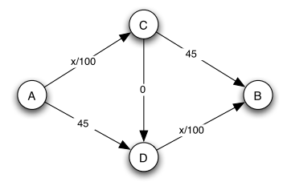
Routing Games
Braess‘s Paradox
A new road can hurt performance at equilibrium

Slide 29
Routing Games
Theorem
The average latency of traffic at Nash equilibrium is at most 2x the latency of optimal traffic
Assumes linear latencies on edges („ax+b“)
A better bound of 1.33x is known.
In other words:
If people were somehow told what routes they should drive, the average latency would at most 33% better than when everyone selfishly picks a route

Slide 30
Auctions
Selling one item, but don‘t know how much it‘s worth
Each bidder (player) has her own intrinsic value for the item.
Willing to purchase it up to this price
Values are independent
Auctions help us discover this value
Goal: Maximize social welfare
Sell item to the person who wants it the most
In terms of own value, not the bid!

Slide 31
Auctions
Dutch auctions
Price gradually decreased until somebody offers, and gets the item at that price
Sealed-bid 1st –price auctions
Person who wrote the highest bid in an envelope gets it at that price
Properties
Dutch auctions are strategically equivalent to sealed-bid 1st –price auctions
They are not truthful: underbidding is a dominant strategy for all players
E.g. bidding (n-1)/n fraction of your value (in uniform distribution) when there are n players
They maximize social welfare (i.e. efficiency)

Slide 32
Auctions
English auctions
Price gradually raised until all bidders drop out, person with last offer given the item
Sealed-bid 2nd –price auctions (Vickrey)
Person with highest bid gets item, but pays second highest bid
Properties
English auctions are strategically equivalent to Vickrey auctions
They are truthful: people bid their true value
They maximize social welfare in equilibrium.

Slide 33
Auctions
How much does the seller make?
1st -price and Dutch auctions:
Bidders reduce their bids by a factor of (n-1) / n
Expect largest bid to be n / (n+1)
Expect revenue: (n-1) / (n+1)
2nd price and English auctions:
Seller commits to collecting less than max. bid
Look at highest and second-highest bids
Expect revenue: (n-1) / (n+1)
Known as revenue equivalence

Slide 34
Part IV (and V)
Chapters 13 - 15, 18

Slide 35
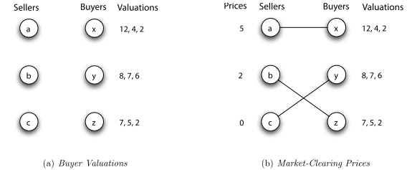
Sponsored search
Need to auction multiple ad slots with different properties
If we knew buyers‘ valuations, we could use a matching market

Slide 36
Sponsored search
Theorem
We can always set prices so that if buyers buy the item they most want, all items are sold (market clearing prices)
Done by gradually raising prices until there is a unique perfect matching between buyers and sellers
Market clearing prices always produce socially optimal outcome
But we don‘t know the valuations...
Want to encourage truthful bidding

Slide 37
Sponsored search
Google‘s Model: Generalized Second Price Auction
Slot i is assigned to the i^{th} highest bidder at a price per click equal to the (i+1)^{st} highest bidder‘s bid
But this does not encourage truthful bidding!
However, it may give Google higher revenue even though this is not well understood

Slide 38
Sponsored search
VCG mechanism
Idea: Each individual is charged the harm they caused the rest of the world
Theorem
Truthful bidding is a dominant strategy in VCG for each buyer
The VCG assignment is socially optimal
It maximizes the total valuation of any perfect matching of slots and advertisers

Slide 39
Structure of the web
Hyperlinks on the web form a directed graph
In the early days, links were navigational
Now many links are transactional
E.g. when you click on your shopping basket
Two types of directed graphs
DAG (Directed Acyclic Graph)
If u can reach v, then v cannot reach u
Strongly connected
Any node can reach another via a directed path
Theorem
Any directed graph can be expressed in terms of these two types

Slide 40
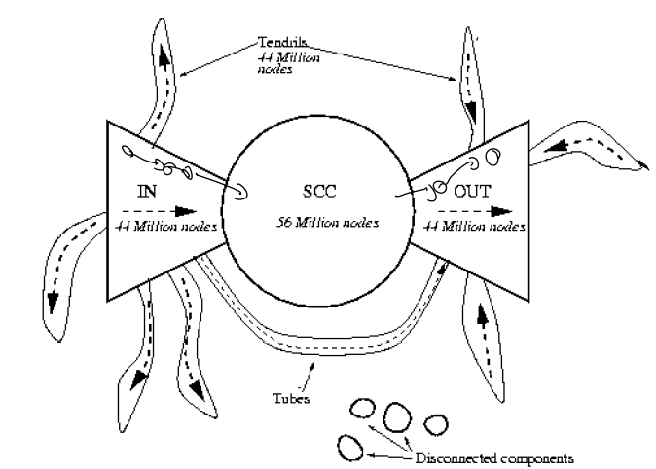
Structure of the web
Strongly connected component (SCC)
Every pair of nodes can reach each other
No larger set with this property
Theorem
Every directed graph is a DAG on its SCCs
On the web, there is just one giant SCC

Slide 41
Ranking web pages
How should we sort search results?
Observation
Should do link analysis, i.e. consider links to be votes
Hubs and authorities (HITS)
Quality as an expert (hub)
Total sum of votes of pages pointed to
Quality of content (authority)
Total sum of votes of experts
Principle of repeated improvement
Theorem
HITS converges to a single stable point
Sort results by decreasing authority score

Slide 42
Ranking web pages
Hubs and authorities depend on the topic (e.g. „cars“). Expensive to compute.
PageRank
A page is important if it is pointed to by other important pages
Again, principle of repeated improvement
On what websites will a random web surfer spend his time?
PageRank(i) = probability the random web surfer visits page i at any given time
Sort result pages by decreasing PageRank
Fact: PageRank is the first eigenvector of the adjacency matrix

Slide 43
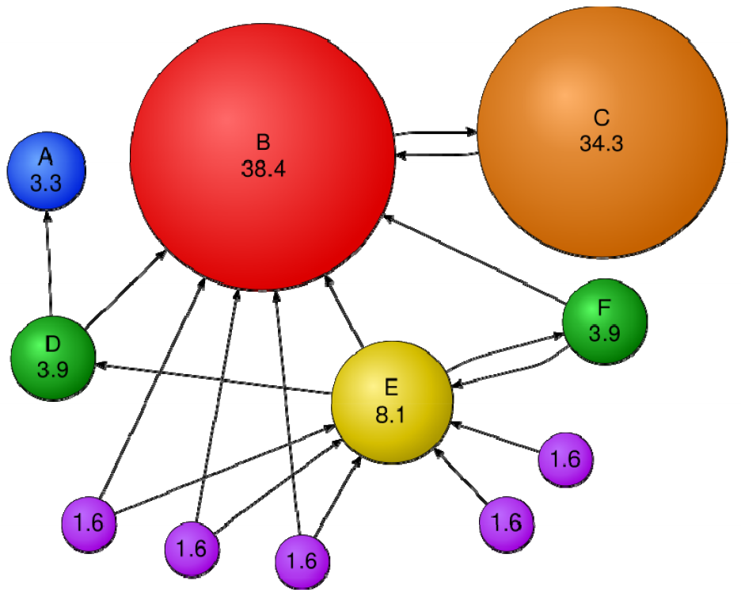
PageRank example

Slide 44
Ranking web pages
Properties of PageRank
Problem: Spider traps and dead ends
Places where you can‘t get back to the SCC
Solution: Do random jumps (teleports) to any page about 15% of the time
Ranking is independent of the topic unlike HITS
Could do personalized PageRank by teleporting to topic-relevant page instead

Slide 45
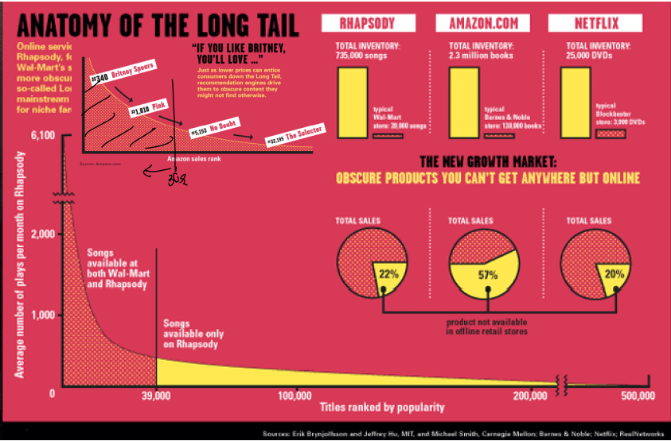
Power laws
It is not unlikely to find someone who has double your wealth (or salary)
Far less likely to find someone who‘s double your height (i.e. normal distribution)
Such distributions are heavy-tailed
E.g. Amazon‘s sales rank

Slide 46
Power laws
Look at the in-degree distribution of the web
Very many pages have a small degree
But reasonbly many pages with an insane number of in-links
Power-laws
Bulk of the degree distribution shows up as a line on log-log scale
The fraction of pages that have k in-links is approximately 1 / k², a power-law
More generally:
if the fraction of (population) that has k (something) follows 1 / k^{α} then power-law with exponent α

Slide 47
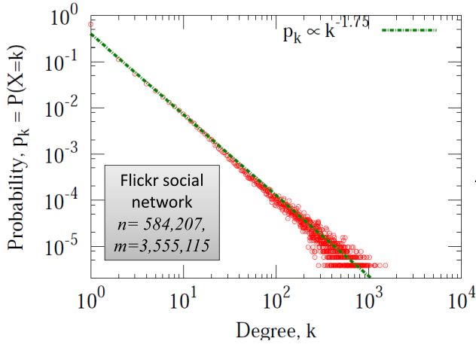
Power laws
Exponent typically between 2 and 3 for any popularity measure (many examples!)

Slide 48
Power laws
Why do power laws arise?
Preferential attachment model
A.k.a. rich-get-richer model
Idea: People have a tendency to copy decisions of people who act before them
Web pages arrive sequentially
With probability p they:
Link to a previous page uniformly at random
With probability 1-p they:
Link to a page with probability proportional to that page‘s in-degree
Theorem: This model produces a network with a power-law degree distribution
The exponent is 1+1/(1-p)

Slide 49
Part VI
Chapters 16,17, 19 and 20

Slide 50
Information cascades
Herding or information cascade
You join a crowd even if it contradicts your private information
Could be rational: Others might have more information than you do!
Cascades may not lead to optimal outcome
First few people could be wrong
Cascades can be based on very little information
People start ignoring their private information once the cascade begins
Cascades are not robust
Only a bit more information can break it
Emperor‘s new clothes

Slide 51
Collective action
Some decisions have direct benefit effects
The „network effect“ – buying a fax machine is better for all previous fax machine owners
Model where everybody sees all actions
Each person i has a threhold t_{i}
Will adopt behavior if at least t_{i} other people are adopters
F(x) = fraction of people with threshold ≤ t_{i}
Can simulate the dynamics to find a fixed point
When F(x) = x, no more changes to adoptions

Slide 52
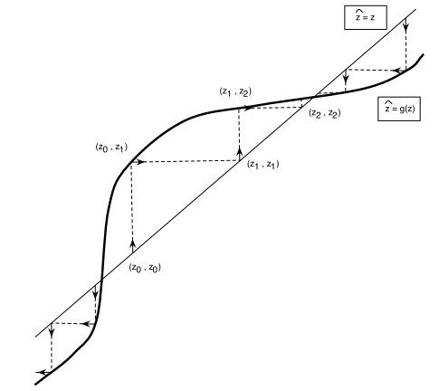
Network effects
Number of adoptions will increase to the next fixed point
F(x)
x (number of adopters)
Number of adoptions will decrease to the next fixed point

Slide 53
Network effects
But model ignores the network
How should we organize a revolt?
Personal threshold k: I will show up if at least k people show up.
People know the threshold of their friends
Each person is playing a 2-person game with each of his friends
Great if both choose same option
Payoff: a if both choose A, b if both choose B
Fact: Node will choose A if b/(a+b) fraction of friends choose A

Slide 54
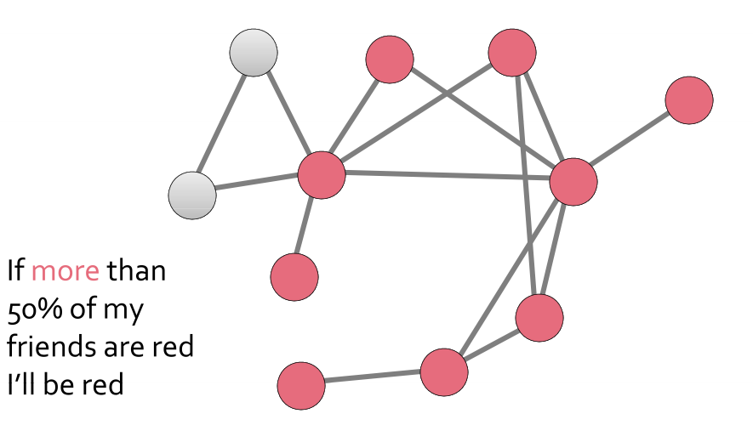
Network effects
Theorem
The use of a new technology A spreads monotonically (i.e. nobody will switch back)

Slide 55
Small world phenomenon
People are connected by short paths
Milgram experiment: six degrees of separation
MSN experiment: average of 6.7 hops
Surprising because social networks tend to have high clustering coefficients
This impedes the exponential growth (i.e. assuming my 100 friends each have a 100 distinct friends, etc.)

Slide 56
Small world models
Suppose all edges are created independently with probability p
The Erdos-Renyi random graph model
Properties

Slide 57
Small world models
Theorem
The diameter of a random 3-regular graph on n nodes is O(log n) with high probability.
Gives us a working definition of what „short paths“ really means: O(log n)
But Erdos-Renyi random graphs don‘t capture triadic closure as in social networks
Modify model to have lots of local edges, and a few random links

Slide 58
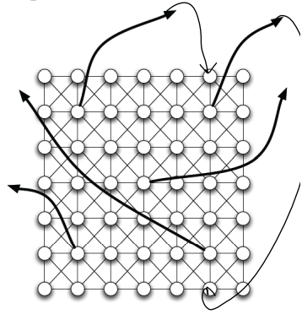
Small world models
Watts-Strogatz model
Goal: Create a random graph with lots of triangles (local edges) and small diameter
Start with a regular lattice (e.g. ring or a grid)
Rewire:
For each edge with prob. p, move the other end to a random vertex
Theorem
Diameter is O(log n)

Slide 59
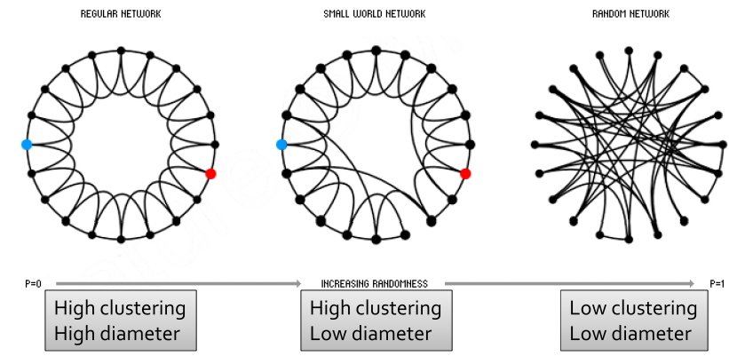
Small world networks

Slide 60
Small world networks
Observation: People are able to find these short paths in a decentralized way!
Geographic navigation should work in poly-logarithmic time
Geographic navigation: Forward the message to the node I know closest to the destination
Not captured by the Watts-Strogatz model
Theorem: Takes at least n^{2/3} steps to reach target
Need a model such that geographic navigation algorithm works naturally

Slide 61
Small world networks
Kleinberg‘s model
The random edges in the Watts-Strogatz model were too random for navigation
Create long-range edges with probability
P[u links to v] = 1 / distance(u,v)^{α}
distance(u,v) is the grid distance between u and v
High α: Mostly know people close by
Low α: Know people from very far away
Theorem
For α=2, geographic navigation takes O(log² n) time
For α≠2, no algorithm can navigate in poly-log time
Actually it‘s α=dimension of the grid

Slide 62
Small world networks
Kleinberg‘s model fits real-world data well
Using ZIP-codes in LiveJournal and measuring distance by rank (# people living closer), get an excellent fit to 1 / rank(u,v)
Implications for peer-to-peer networks
Can construct networks that allow for efficient search for content
Chord from MIT is the best known
Efficient: find a file using O(log n) messages

