Slide 1
The Structure of Networks
with emphasis on information and social networks
T-214-SINE Summer 2011
Chapter 9
Ýmir Vigfússon

Slide 2
Auctions (uppboð)
Another application of game theory
How should I bid strategically as a buyer?
What mechanism should I use for selling?
Auctions are commonplace
Historical sale tool
Bonds, treasury bills, land leases, privatization, art, etc.
Internet marketplace
eBay changed the landscape as a gigantic auctioneer
Sponsored search (Google, Facebook, etc.)
Exciting research going on

Slide 3
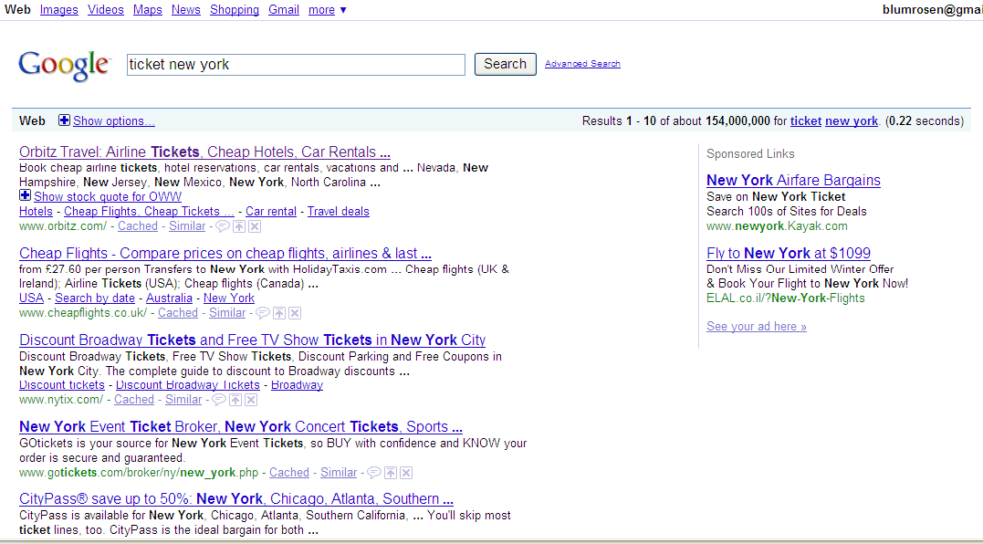
Auctions for Sponsored Search
Real (“organic”) search result
Ads: “sponsored search”

Slide 4
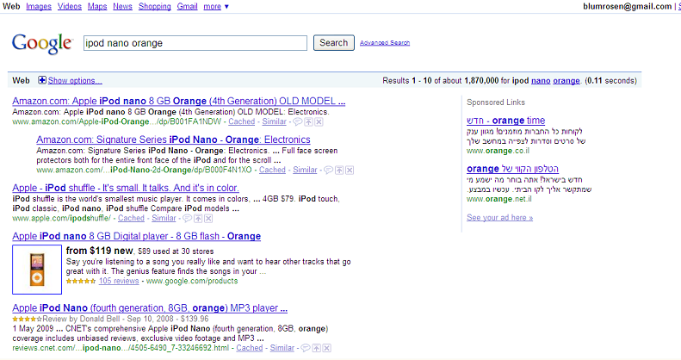
Auctions for Sponsored Search

Slide 5
Auctions for Sponsored Search
An online auction is run for every individual search.
Massive scalability challenges
Billion dollar markets!
Advertising is effective.
Targeted.
Users in search mode.
Pay-per-click auctions (mostly)
How are ads sold?
We’ll hopefully cover this later (in chapter 15)

Slide 6
Market design and sponsored search
Google’s revenue from sponsored search:
Billions of dollars each quarter.
Every little detail matters.
Advertisers are “selfish” agents:
Will manipulate the auction if possible.
Complex software development:
hard to experiment → theory to the rescue…
Big internet companies (Google, eBay, Microsoft, Yahoo, Facebook, etc.) are hiring well-known economists to design their markets.
Use auction theory.

Slide 7
Settings
Imagine we want to sell a single item
Later we‘ll extend this to multiple items
We don‘t know what it‘s generally worth
Just what it‘s worth to us
We may set a reserve price (later)
Each bidder (player) has her own intrinsic value of the item.
Willing to purchase it up to this price
Values are independent
But we don‘t know these values
Differs from our previous game theory assumptions about knowledge of payoffs
How should we proceed?

Slide 8
First steps
Simplify
Suppose we knew the intrinsic values of the item to the bidders
No need for an auction
Suppose seller values item at x
Suppose potential buyer values it at y
What will happen?

Slide 9
First steps
Commitment to a mechanism is power
Surplus = y - x
If the seller decides on the mechanism
She gets (most) of the surplus
If the buyer decides the mechanism
He gets (most) of the surplus
If decided together somehow
Variant of bargaining (we won‘t cover this)
Okay, but what if we don‘t know the intrinsic values?

Slide 10
First steps
We could just ask how much people are willing to pay
But would they lie?
Or manipulate the outcome?
Problem:
How do we motivate buyers to reveal their true values?
Auction theory sub-field of Mechanism Design
We design the market, „Economists as engineers“
Design an auction so that in equilibrium we get the results that we want

Slide 11
Goal of auctions
A seller (“auctioneer”) may have several goals.
Most common goals:
Maximize revenue (profit)
Maximize social welfare (efficiency)
Give the item to the buyer that wants it the most. (regardless of payments.)
Fairness: for example, give items to the poor.
This is our focus today.

Slide 12
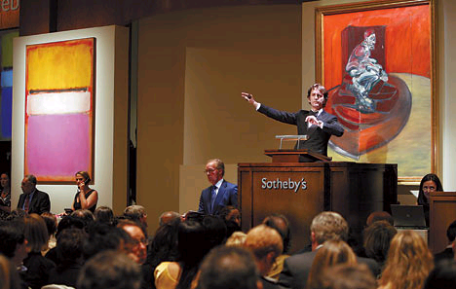
Types of auctions
Ascending-bid (English auctions)

Slide 13
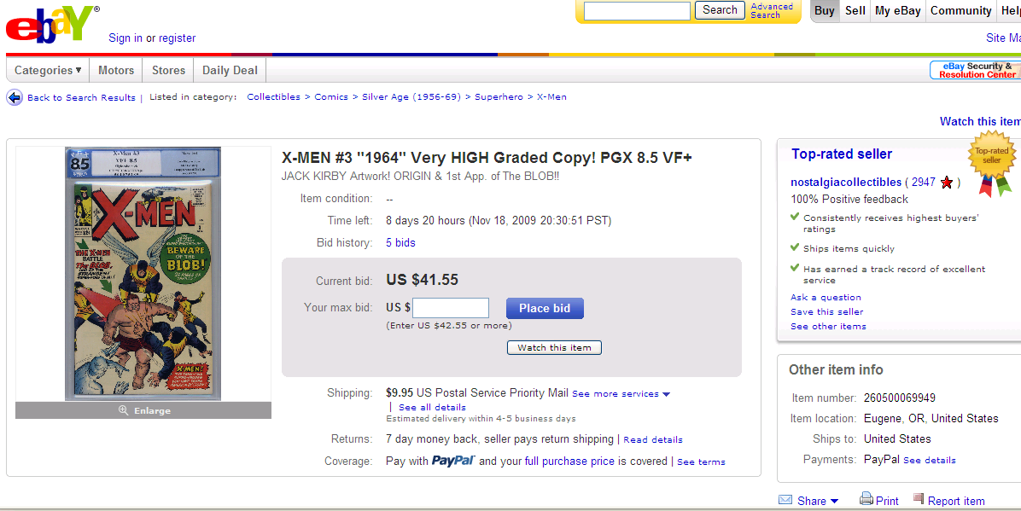
English Auctions at ebay

Slide 14
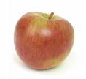
English auction - rules
Price p is announced each time.
At the beginning, p=0.
Raising hand by a buyer: Agreeing to buy the item for p + $1.
If no bidder raised his hand for 1 minute, the item is sold.
To the bidder who made the last offer.
She pays her last offer.
at $3
p=0
p=1
p=2
p=3
bid=1
bid=3
bid=2

Slide 15
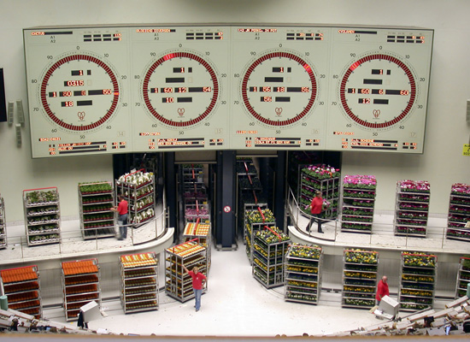
Dutch Auctions
Dutch Flower Market

Slide 16
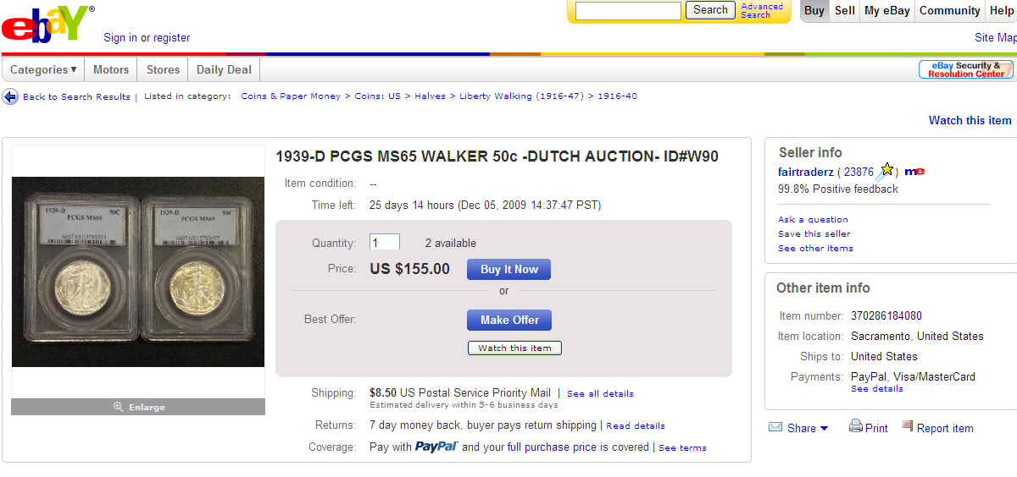
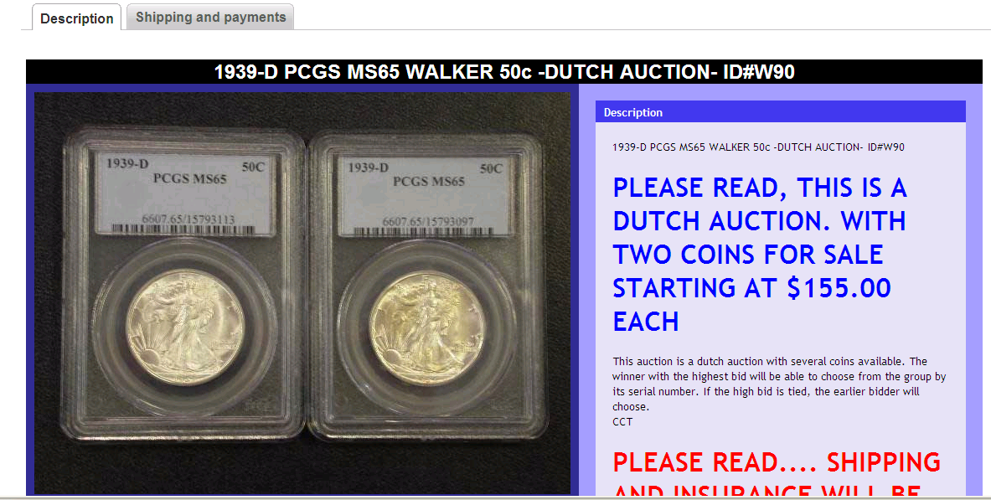
Today

Slide 17
Dutch auction - rules
Price p is announced each time.
At the beginning, p = maximum price.
Seller lowers the price by $1 at each period.
First buyer to raise his hand, wins the items.
He pays the current price.
at $97
p=100
p=99
p=98
p=97
Me!

Slide 18
Dutch auctions - trivia
One advantage: quick.
Only requires one bid!
US department of treasury sells bonds using Dutch auctions.
The IPO for Google’s stock was done using a variant of a Dutch auction.

Slide 19
Four auctions
We will now present the following auctions.
English Auctions
Dutch Auctions
1st-price/”pay-your-bid” auctions
2nd-price/Vickrey auctions
“Open Cry”
auctions
“Sealed bid”
auctions

Slide 20
1st -price auctions
Each bidder writes his bid in a sealed envelope.
The seller:
Collects bids
Open envelopes.
Winner: bidder with the highest bid.
Payment: winner pays his bid.
Note: bidders do not see the bids of the other bidders.
at $8
$5
$8
$5
$3

Slide 21
2nd -price auctions
Each bidder writes his bid in a sealed envelope.
The seller:
Collects bids
Open envelopes.
Winner: bidder with the highest bid. Payment: winner pays the 2nd highest bid.
Note: bidders do not see the bids of the other bidders.
at $5
$2
$8
$5
$3

Slide 22
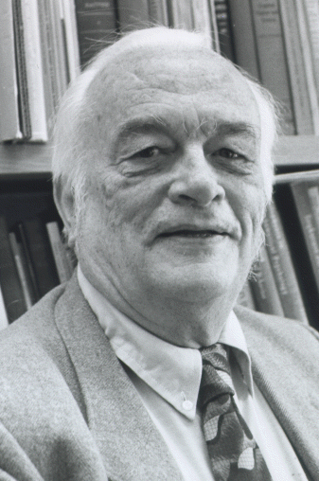
2nd-price=Vickrey
Second-price auctions are also known as Vickrey auctions.
Auction defined by William Vickrey in 1961.
Won the Nobel prize in economics in 1996.
Died shortly before the ceremony…
(we will see his name again later in the course…)

Slide 23
Relations between auctions
English Auction
Dutch auction
1st-price auction
2nd-price auction
How do they relate to each other?

Slide 24
Equivalent auctions 1
1st-price auctions are strategically equivalent to Dutch auctions.
Strategies:
1st-price: given that no one has a higher bid, what is the maximum I am willing to pay?
Dutch: Given that nobody has raised their hand, when should I raise mine?
No new information is revealed during the auction!
$30
$100
$55
$70

Slide 25
Equivalent auctions 2
2st-price auctions are equivalent* to English auctions.
Given that bidders bid truthfully, the outcomes in the two auctions are the same.
Actually, in English auctions bidders observe additional information: bids of other players. (possible effect: herd phenomena)
But do bidders bid truthfully?
$30
$100
$55
$70

Slide 26
Modeling
n bidders
Each bidder has value v_{i} for the item
“willingness to pay”
Known only to him – “private value”
If Bidder i wins and pays p_{i}, his utility is v_{i} – p_{i}
Her utility is 0 when she loses.
Note: bidders prefer losing than paying more than their value.

Slide 27
Auctions scheme
values
bids
v₁
b₁
v₂
b₂
winner
payments
$$$
v₃
b₃
v₄
b₄

Slide 28
Strategy
A strategy for each bidder: how to bid given your intrinsic value?
Examples for strategies:
b_{i}(v_{i}) = v_{i} (truthful)
b_{i}(v_{i}) = v_{i} /2
b_{i}(v_{i}) = v_{i} /n
If v<50, b_{i}(v_{i}) = v_{i} otherwise, b_{i}(v_{i}) = v_{i} +17
Can be modeled as normal form game, where these strategies are the pure strategies.
Example for a game with incomplete information.
 | B(v)=v | B(v)=v/2 | B(v)=v/n | ….
B(v)=v
…

Slide 29
Strategies and equilibrium
An equilibrium in the auction is a profile of strategies B₁,B₂,…,B_{n} such that:
Dominant strategy equilibrium: each strategy is optimal whatever the other strategies are.
Nash equilibrium: each strategy is a best response to the other strategies.
Again: a strategy here is a function, a plan for the game. Not just a bid.
 | B(v)=v | B(v)=v/2 | B(v)=v/n | ….
B(v)=v
…

Slide 30
Equilibrium behavior in 2nd-price auctions
Theorem: In 2nd-price auctions truth-telling is a dominant strategy.
in English auctions too (with private values)
That is, no matter what the others are doing, I will never gain anything from lying.
Bidding is easy, independent from our beliefs on the value of the others.
Conclusion: 2nd price auctions are efficient (maximize social welfare).
Selling to bidder with highest bid is actually selling to the bidder with the highest value.

Slide 31
Truthfulness: proof
Let’s prove now that truthfulness is a dominant strategy.
We will show that Bidder 1 will never benefit from bidding a bid that is not v₁.
v₁
Case 1: Bidder 1 wins when bidding v₁.
v₁ is the highest bid, b₂ is the 2nd highest.
His utility is v₁ - b₂ > 0.
Bidding above b₂ will not change anything (no gain from lying).
Bidding less than b₂ will turn him into a loser - from positive utility to zero (no gain from lying).
b₂

Slide 32
Truthfulness: proof
Let’s prove now that truthfulness is a dominant strategy.
We will show that Bidder 1 will never benefit from bidding a bid that is not v₁.
Case 2: Bidder 1 loses when bidding v₁.
Let b₂ be the 2nd highest bid now.
His utility 0 (losing).
Any bid below b₂ will gain him zero utility (no gain from lying).
Any bid above b₂ will gain him a utility of v₁-b₂ < 0 - losing is better (no gain from lying).
b₂
v₁

Slide 33
Efficiency in 2nd-price auctions
Since 2nd-price is truthful, we can conclude it is efficient:
That is, in equilibrium, the auction allocates the item to the bidder with the highest value.
With the actual highest value, not just the highest bid.
Without assuming anything on the values
(For every profile of values).

Slide 34
Remark: Efficiency
We saw that 2nd –price auctions are efficient.
What is efficiency (social welfare)? The total utility of the participants in the game (including the seller).
For each bidder: v_{i} – p_{i}
For the seller: (assuming it has 0 value for the item)
Summing:

Slide 35
What we saw so far…
2nd price and English auctions are:
Equivalent*
Have a truthful dominant-strategy equilibrium.
Efficient in equilibrium.
1st -price and Dutch auctions are:
Equivalent.
Truthful?
Efficient?

Slide 36
1st price auctions
Truthful?
NO!
$31
$30
$100

Slide 37
Bayesian analysis
There is not dominant strategy in 1st price auctions.
How do people behave?
They have beliefs on the preferences of the other players!
Beliefs are modeled with probability distributions.

Slide 38
Bayes-Nash equilibrium
Definition: A set of bidding strategies is a Nash equilibrium if each bidder’s strategy maximizes his payoff given the strategies of the others.
In auctions: bidders do not know their opponent’s values, i.e., there is incomplete information.
→ Each bidder’s strategy must maximize her expected payoff accounting for the uncertainty about opponent values.

Slide 39
Continuous distributions
A brief reminder of basic notions in statistics/probability.

Slide 40
Continuous distributions
Reminder:
Let V be a random variable that takes values from [0,t].
Cumulative distribution function F:[0,t]→[0,1] F(x) = {Probability that V<x} = Pr{V<x}
The density of F is the density distribution f(x)=F’(x).
The expectation of V:

Slide 41
Example: The Uniform Distribution
What is the probability that V<x?
F(x)=x.
Density: f(x)=1
Expectation:
0
0.25
0.5
0.75
1
0
1
Area = 1
0
1

Slide 42
Auctions with uniform distributions
A simple Bayesian auction model:
2 buyers
Values are between 0 and 1.
Values are distributed uniformly on [0,1]
What is the equilibrium in this game of incomplete information?
Are 1st-price auctions efficient?

Slide 43
Equilibrium in 1st-price auctions
Claim: bidding b(v)=v/2 is an equilibrium
2 bidders, uniform distribution.
Proof:
Assume that Bidder 2’s strategy is b₂(v)=v₂/2.
We show: b₁(v)=v₁/2 is a best response for Bidder 1.
(clearly, no need to bid above 1).
Bidder 1’s expected utility is: Prob[ b₁ > b₂ ] × (v₁-b₁) =
Prob[ b₁ > v₂/2 ] × (v₁-b₁) =
2b₁ * (v₁-b₁)
[ 2b₁ * (v₁-b₁) ]’ = 2v₁-4b₁ = 0 (maximize for b₁)
→ b₁ = v₁/2 (→ it is a best response for b₂=v₂/2)
If v₂ < 2/3 then b₁ wins.
0
b₁=1/3
2/3
1

Slide 44
Equilibrium in 1st-price auctions
We proved: bidding b(v)=v/2 is an equilibrium
2 bidders, uniform distribution.
For n players: bidding b_{i}(v_{i}) = by all players is a Nash equilibrium.
(with more competition, you will bid closer to your true value)
Conclusion: 1st-price auctions are efficient
(not truthful, but in equilibrium the bidder with the highest bid wins).

Slide 45
Equilibrium in 1st-price auctions
We proved: 1st-price auction is efficient for the uniform distribution.
What about general distributions?
Turns out: Yes!
We won’t go into the math

Slide 46
Equilibrium in 1st-price auctions
We proved: 1st-price auction is efficient for the uniform distribution.
What about general distributions?
Notation: let v₁,…,v_{n-1} be n-1 draws from a distribution F. Let max_{[n-1]} = max{v₁,…,v_{n-1}} (highest-order statistic)

Slide 47
Equilibrium in 1st-price auctions
When v₁,…,v_{n} are distributed i.i.d. from F
F is strictly increasing
Claim: the following is a symmetric Nash equilibrium
That is, each bidder will bid the expected winning bid of the other players, given that v_{i} wins.
The above b_{i}(v_{i}) is strictly monotone in v_{i} → 1st-price auction is efficient.
Example:
Proof: next week (it will be a corollary of another result).

Slide 48
What we saw so far…
2nd price and English auctions are:
Equivalent*
Have a truthful dominant-strategy equilibrium.
Efficient in equilibrium. (“efficient”)
1st -price and Dutch auctions are:
Equivalent.
Truthful???
Efficient???
Actually true for all distributions, not just the uniform distribution.
No!
Yes!

Slide 49
Revenue equivalence
How much does the seller make?
1st -price and Dutch auctions:
Bidders reduce their bids by a factor of (n-1) / n
Expect largest bid to be n / (n+1)
Expect revenue: (n-1) / (n+1)
2nd price and English auctions:
Seller commits to collecting less than max. bid
Look at highest and second-highest bids
Expect revenue: (n-1) / (n+1)
This holds for very many auction formats!

Slide 50
Model and real life
We discussed a simplified model. Real auctions are more complicated.
Do bidders know their values?
If so many people are willing to pay more than $100, it possibly worth it. (English auctions may help discover the value.)
Auctions are (usually) repeated, and not stand-alone.
Budgets and wealth effects.
I think that this TV is worth $1000, but my wife will divorce me if I pay more than $100.
Manipulation is not only with bids:
collusion, false name bids, etc.
Do bidders have accurate probabilities?
Do bidders behave rationally?

