Slide 1
The Structure of Networks
with emphasis on information and social networks
T-214-SINE Summer 2011
Chapter 8
Ýmir Vigfússon

Slide 2
Game theory in networks
What we have discussed so far
Network structure
Regular game theory
Evolutionary game theory
Today we will combine game theory with networks
Look at choosing a route in traffic
Equivalently: network route for packets

Slide 3
Abstraction
Why should traffic be amenable to game theoretic reasoning?
Individual don‘t choose routes in isolation
They evaluate decisions of each another and reason about traffic congestion
What will we learn?
Adding capacity to a network can sometimes slow down the traffic!
But it‘s never too bad

Slide 4

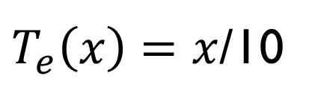
Routing networks
Traffic wants to flow from some source to some destination
Here, the people at s want to drive to t
Edges have latency or delay
Latency of upper edge e depends on how many choose it
Latency of lower edge e‘ always 1 hour
$T_{e}\left(x\right)=x$/10
s
t
$$T_{e´}\left(x\right)=1$$

Slide 5

Routing games
All players (drivers) are making private decisions about what path to drive
We now have lots of players, not just two
Each wants to minimize latency of the path
This is the payoff
Suppose 10 (100) commuters on the road
What happens in the game?
$$T_{e}\left(x\right)=x/10$$
s
t
$$T_{e´}\left(x\right)=1$$

Slide 6
Routing games
Players have to reason about the latency of the upper edge
„How many people do I think are driving there now?“
If too many, I‘ll take the lower edge
This doesn‘t give a stable outcome
More useful to ask:
What is traffic like at Nash equilibrium?

Slide 7
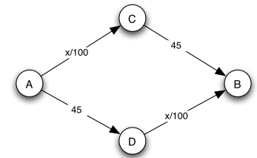
Another example
Highway network, two routes.
Latencies marked on the edges
Suppose 4,000 cars go from A to B
What will be the average travel time?

Slide 8
Another example
If everyone takes upper route
4000/100+45 = 85 minutes
If everyone takes lower route
45+4000/100 = 85 minutes

Slide 9
Another example
But if they divide up evenly
2000/100+45 = 65 minutes
What will happen at equilibrium?

Slide 10
Another example
Dividing up equally is a Nash equilibrium
No driver has has an incentive to switch over to the other route
This is the only Nash equilibrium
Consider strategy where x drivers use upper route, and 4000-x use lower route
If x is not 2000, then routes will have unequal travel time
Thus users of slower route will want to switch to the faster route
Therefore, x ≠2000 can‘t be a Nash equilibrium

Slide 11
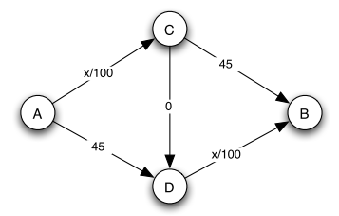
Braess‘s Paradox
New amaizng highway is built from C to D
What will happen at equilibrium?
Everyone picks the A,C,D,B route!

Slide 12
Braess‘s Paradox
(see other slide set)

Slide 13
Refresher: Internet Routing
How do packets get from A to B in the Internet?
Internet
A
B

Slide 14
Connectionless Forwarding
Each router (switch) makes a local decision to forward the packet towards B
Does this mess up our game theory model?
R1
R4
R7
R6
A
R2
B
R8
R3
R5

Slide 15
Connectionless Forwarding
This process is termed destination-based connectionless forwarding
How does each router know the correct local forwarding decision for any possible destination address?
Through knowledge of the topology state of the network
This knowledge is maintained by a routing protocol

Slide 16
Routing Protocols
Distribute the knowledge of the current topology state of the network to all routers
This knowledge is used by each router to generate a forwarding table
contains the local switching decision for each known destination address

Slide 17
Routing Protocols
Correct operation of the routing state of a network is essential for the management of a quality network service
accuracy of the routing information
dynamic adjustment of the routing information
matching aggregate traffic flow to network capacity

Slide 18
ISP Routing Tasks
customers
internal
peer / upstream
Exterior routing
Interior routing
Customer routing

Slide 19
Interior Routing Protocols
Interior Routing
discovers the topology of a network through the operation of a distributed routing protocol
Describe the current network topology
Routing protocols distribute how to reach address prefix groups
Routing protocols function through either
distributed computing model (distance vector)
parallel computing model (link state)

Slide 20
Path Selection
R1
R4
5
R7
40
45
5
6
5
10
R6
20
R2
B
A
10
15
R8
4
10
R3
5
R5
10
Minimum cost from A to B is 39 units

Slide 21
Dynamic Path Adjustment
R1
R4
5
R7
40
45
5
6
5
10
R6
20
R2
B
A
10
15
R8
4
R3
R5
10
5
If R5 – R7 breaks, minimum cost path from A to B is
Now 46 units

Slide 22
Routing Protocols
Distance Vector Routing Protocols
E.g. RIP protocol
Each node sends its routing table (dest, distance) to all neighbors every 30 seconds
Lower distances are updated with the neighbor as next hop
cannot scale
cannot resolve routing loops quickly

Slide 23
Routing Protocols
Link State Routing Protocols
Each link, the connected nodes and the metric is flooded to all routers
Each link up/down status change is incrementally flooded
Each router re-computes the routing table in parallel using the common link state database
OSPF is the main protocol in use today

Slide 24
Take away
Users at home have no say as to which of multiple routes their packets take
Chosen entirely by routers
But every router is making shortest-path decisions on behalf of all the packets it forwards
Routers are thus not just reasoning locally
So in practice, our game theory model works when we deal with ISP routers instead of home users
Only a minor perceptual change!

Slide 25
Summary of what we learned
Routing games
Regular/network traffic with game theory
A new road can hurt performance at equilibrium
Known as Braess‘s paradox
Best response dynamics finds equilibrium
Thm: Traffic at equilibrium is at worst twice as bad as optimal traffic (social optimum)
Better bound: factor of 4/3 [Tardos,Roughgarden]
Network traffic

