Slide 1
The Structure of Networks
with emphasis on information and social networks
T-214-SINE Summer 2011
Chapter 6
Ýmir Vigfússon

Slide 2
Game theory
Network science deals with connectedness
Underlying structure of interconnecting links
Interdependence in behavior of agents in the system
Game theory deals with the outcome of person‘s decisions in various situations
How to choose among different options
People‘s choices when interacting with others
Studied for about 90 years
Mostly within economics, more recently in other fields

Slide 3
Why study game theory?
Sheds light on many situations
Pricing of new products
International relations
Using performance-enhancing drugs
Ideas relevant even when no-one is overtly making decisions
E.g. evolutionary biology
Outcomes of situations depend on what other organisms are doing
Network traffic (or vehicle traffic) – discuss later
Which behaviors tend to sustain themselves when carried out in a larger population?

Slide 4
What is a game?
Many of the motivating examples are in fact from actual games
Soccer penalty kick, board games, “chicken“
Model of course more widely applicable
Def: A game consists of three things.
(1) A set of players
(2) Each player has set of options how to behave called strategies
(3) For each choice of strategies, each player receives a payoff from the game.

Slide 5
Example (1/2)
Suppose you can either study for the exam or the presentation for a course
Want to maximize your average grade
Your partner has to make a similar choice
Exam
By studying for the exam, you get 92, else 80
Presentation
If both prepare, each gets 100; if one prepares 92, but if neither prepares you both get 84.
Can‘t communicate, how do you decide?
Your partner will also need to decide...

Slide 6
Example (2/2)
Your partner
What will happen in this game?
Each player thinks studying for exam is safer
 | Presentation | Exam
Presentation | 90,90 | 86,92
Exam | 92,86 | 88,88
You
Strategies
Payoff for
row player,column player

Slide 7
Reasoning about behavior in a game
How are the players likely to behave?
Need a few assumptions
The payoff for a player should capture all rewards
Including altruism
Players know all possible strategies and payoffs to other players
Not always true!
Players are rational
Each players wants to maximize her own payoff
Each player succeeds in picking the optimal strategy

Slide 8
Reasoning about behavior in a game
Let‘s look at behavior in the example
Each player has a strictly dominant strategy
“Exam“ strategy strictly better than all other options
No matter what your partner does, you should study for the exam
We can predict the outcome
But both could be better off!
The 90,90 outcome won‘t happen during rational play

Slide 9
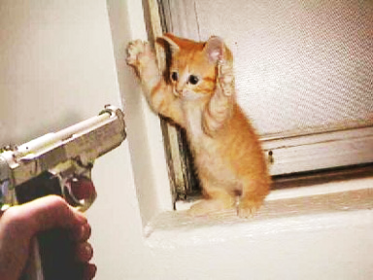
The prisoner‘s dilemma
Two suspects arrested and suspected for robbery.
Interrogated separately
If neither confesses, both get 1 year sentence
If one confesses, other person gets 10 years
If both confess, 4 years in prison each
 | Don‘t confess | Confess
Don‘t confess | -1, -1 | -10, 0
Confess | 0, -10 | -4, -4

Slide 10
Interpretations
Confessing is a strictly dominant strategy
Not confessing is better for both of them
But under rational play this is not achieved
The dilemma arises frequently
E.g. performance-enhancing drugs for athletes
Known as “arms races“
The payoffs must be aligned right
 | Don‘t use drugs | Use drugs
Don‘t use drugs | 3, 3 | 1, 4
Use drugs | 4, 1 | 2, 2

Slide 11
Best response
The best choice of one player, given a belief of what the other player will do
Let‘s make this a bit more formal
Player 1 chooses strategy S
Player 2 chooses strategy T
Payoff to player i given S,T is P_{i}(S,T)
Def: S is a best response to T if P₁(S,T) ≥ P₁(S‘,T) for all other strategies S‘ of player 1.
S strict best response when P₁(S,T) > P₁(S‘,T)

Slide 12
Dominant strategy
Def: A dominant strategy is a best response to every strategy of the other player
Analogous for a strictly dominant strategy.
In the prisoner‘s dilemma, both players had strictly dominant strategies
Thus easy to predict what would happen
But what about games without dominant strategies?

Slide 13
Example: Marketing game (1/2)
A game in which only one player has a dominant strategy
Two firms entering markets. Firm 2 established.
60% of people want low-priced, 40% upscale
If they compete directly, Firm 1 gets 80% of sales and Firm 2 gets 20%.
Otherwise, each occupies own market segment
Firm 2
 | Low-Priced | Upscale
Low-Priced | .48, .12 | .60, .40
Upscale | .40, .60 | .32, .08
Firm 1

Slide 14
Example: Marketing game (2/2)
What happens in this game?
Firm 1 has a dominant strategy: Low-priced, whereas Firm 2 does not
Firm 2 can thus assume Firm 1 will play this strategy
Our prediction for this game is .60, .40
Firm 2
 | Low-Priced | Upscale
Low-Priced | .48, .12 | .60, .40
Upscale | .40, .60 | .32, .08
Firm 1

Slide 15
Equilibrium concepts
What if neither player has a dominant strategy?
How should we reason about such games?
We should expect players to use strategies that are best responses to one another
Example:
Three client game.
What is the best response to each strategy?
 | A | B | C
A | 4, 4 | 0, 2 | 0, 2
B | 0, 0 | 1, 1 | 0, 2
C | 0, 0 | 0, 2 | 1, 1

Slide 16
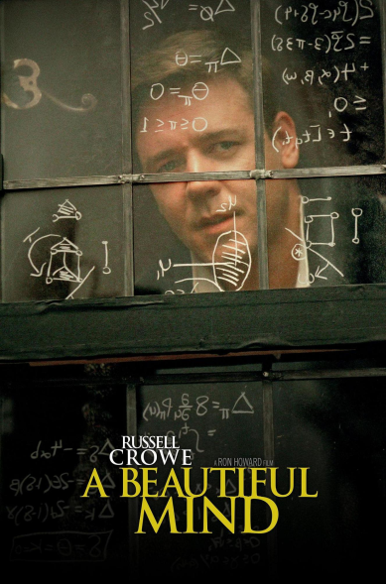
Nash equilibrium
Developed by John Nash in 1950.
Made famous in „A Beautiful Mind“
Def:
For strategy S by player 1 and T by player 2, the pair (S,T) is a Nash equilibrium if S is a best response to T, and T is a best response to S
More generally, at Nash equilibrium if no player wants to unilaterally deviate to an alternative strategy

Slide 17
Example: Nash equilibrium
Three client game
Suppose Firm 1 chooses A and Firm 2 also chooses A
These strategies are the best responses to each other - neither player wants to deviate
Thus (A,A) is a Nash equilibrium.
It is also unique – no other pair works
 | A | B | C
A | 4, 4 | 0, 2 | 0, 2
B | 0, 0 | 1, 1 | 0, 2
C | 0, 0 | 0, 2 | 1, 1

Slide 18
Example: Nash equilibrium
Coordination game
Prepare a presentation with a partner
But don‘t know what software she will use
Incompatibility takes effort
(PowerPoint,PowerPoint) is a Nash equilibrium
(Keynote,Keynote) is also a Nash equilibrium.
Can have multiple Nash equilibria!
 | PowerPoint | Keynote
Powerpoint | 1, 1 | 0, 0
Keynote | 0, 0 | 1, 1

Slide 19
Important games
Battle of the sexes
Which kind of movie to rent?
Two equilibria, but which one will be played?
Hard to predict the outcome
Depends on social conventions
 | Romance | Thriller
Romance | 1, 2 | 0, 0
Thriller | 0, 0 | 2, 1

Slide 20
Important games
Stag Hunt
If hunters work together, they can catch a stag
On their own they can each catch a hare
If one hunter tries for a stag, he gets nothing
Two equilibria, but “riskier“ to hunt stag
What if other player hunts hare? Get nothing
Similar to prisoner‘s dilemma
Must trust other person to get best outcome!
 | Hunt Stag | Hunt Hare
Hunt Stag | 4, 4 | 0, 3
Hunt Hare | 3, 0 | 3, 3

Slide 21
Important games
Hawk-Dove (or Game of Chicken)
Each player either aggressive (H) or passive (D)
If both passive, divide resources evenly
If both aggressive – war! Disastrous for both
Otherwise aggressor wins
Can model the foreign policy of countries
Among many other things
 | Dove | Hawk
Dove | 3, 3 | 1, 5
Hawk | 5, 1 | 0, 0

Slide 22
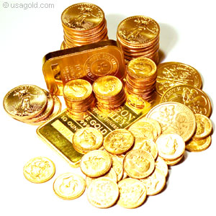
Mixed strategies
Do Nash equilibria always exist?
Matching Pennies game
Player 1 wins on same outcome, 2 on different
Example of a zero-sum game
What one player gains, the other loses
E.g. Allied landing in Europe on June 6, 1944
How would you play this game?
 | Heads | Tails
Heads | -1, +1 | +1, -1
Tails | +1, -1 | -1, +1

Slide 23
Mixed strategies
You are randomizing your strategy
Instead of choosing H/T directly, choose a probability you will choose H.
Player 1 commits to play H with some probability p
Similarly, player 2 plays H with probability q
This is called a mixed strategy
As opposed to a pure strategy (e.g. p=0)
What about the payoffs?

Slide 24
Mixed strategies
Suppose player 1 evaluates pure strategies
Player 2 meanwhile chooses strategy q
If Player 1 chooses H, he gets a payoff of -1 with probability q and +1 with probability 1-q
If Player 1 chooses T, he gets -1 with probability 1-q and +1 with probability q
Is H or T more appealing to player 1?
Rank the expected values
Pick H: expect (-1)(q) + (+1)(1-q) = 1-2q
Pick T: expect (+1)(q) + (-1)(1-q) = 2q -1

Slide 25
Mixed strategies
Def: Nash equilibrium for mixed strategies
A pair of strategies (now probabilities) such that each is a best response to the other.
Thm: Nash proved that this always exists.
In Matching Pennies, no Nash equilibrium can use a pure strategy
Player 2 would have a unique best response which is a pure strategy
But this is not the best response for player 1...
What is Player 1‘s best response to strategy q?
If 1-2q ≠2q-1, then a pure strategy (either H or T) is a unique best response to player 1.
This can‘t be part of a Nash equilibrium by the above
So must have 1-2q=2q-1 in any Nash equilibrium
Which gives q=1/2. Similarly p=1/2 for Player 1.
This is a unique Nash equilibrium (check!)

Slide 26
Mixed strategies
Intuitively, mixed strategies are used to make it harder for the opponent to predict what will be played
By setting q=1/2, Player 2 makes Player 1 indifferent between playing H or T.
How do we interpret mixed equilibria?
In sports (or real games)
Players are indeed randomizing their actions
Competition for food among species
Individuals are hardwired play certain strategies
Mixed strategies are proportions within populations
Population as a whole is a mixed equilibrium
Nash equilibrium is an equilibrium in beliefs
If you believe other person will play a Nash equilibrium strategy, so will you.
It is self-reinforcing – an equilibrium

Slide 27
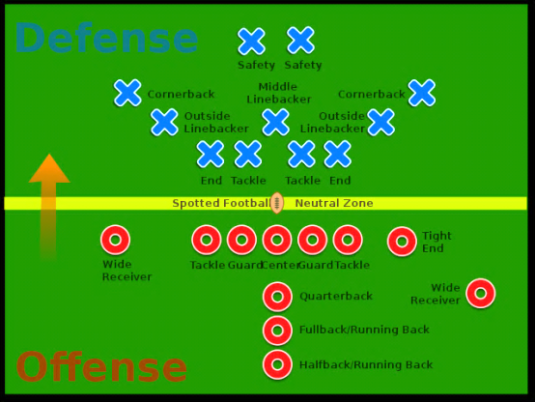
Mixed strategies: Examples
American football
Offense can run with the ball, or pass forward
What happens?
Suppose the defense defends against a pass with probability q
P: expect (0)(q) + (10)(1-q) = 10-10q
R: expect (5)(q) + (0)(1-q) = 5q
Offense is indifferent when q=2/3
 | Defend run | Defend pass
Pass | 0, 0 | 10, -10
Run | 5, -5 | 0, 0

Slide 28
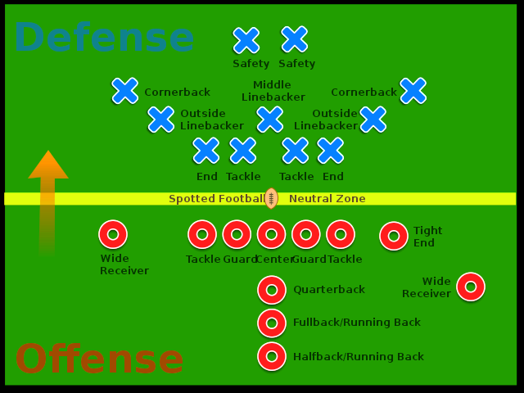
Mixed strategies: Examples
American football
Offense can run with the ball, or pass forward
What happens?
Suppose offense passes with probability p
Similarly, defense is indifferent when p=1/3
(1/3,2/3) is a Nash equilibrium
Expected payoff to offense: 10/3 (yard gain)
 | Defend run | Defend pass
Pass | 0, 0 | 10, -10
Run | 5, -5 | 0, 0

Slide 29
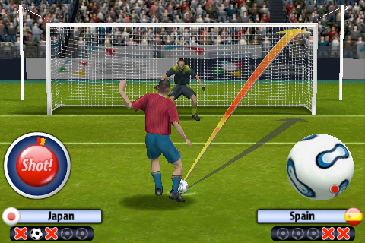
Mixed strategies: Examples
Penalty-kick game
Soccer penalties have been studied extensively
Suppose goalie defends left with probability q
Kicker indifferent when
(0.58)(q) + (0.95) (1-q) = (0.93)(q) + (0.70) (1-q)
Get q =0.42. Similarly p=0.39
True values from data? q=0.42 , p=0.40 !!
The theory predicts reality very well
 | Defend left | Defend right
Left | 0.58, -0.58 | 0.95, -0.95
Right | 0.93, -0.93 | 0.70, -0.70

Slide 30
Pareto optimality
Even playing best responses does not always reach a good outcome as a group
E.g. prisoner‘s dilemma
Want to define a socially good outcome
Def:
A choice of strategies is Pareto optimal if no other choice of strategies gives all players a payoff at least as high, and at least one player gets a strictly higher payoff
Note: Everyone must do at least as well

Slide 31
Social optimality
Def:
A choice of strategies is a social welfare maximizer (or socially optimal) if it maximizes the sum of the players‘ payoffs.
Example:
The unique Nash equilibrium in this game is socially optimal
 | Presentation | Exam
Presentation | 98,98 | 94,96
Exam | 96,94 | 92,92

